Slide 2

What is Computer Vision?
Terminator 2

Slide 3
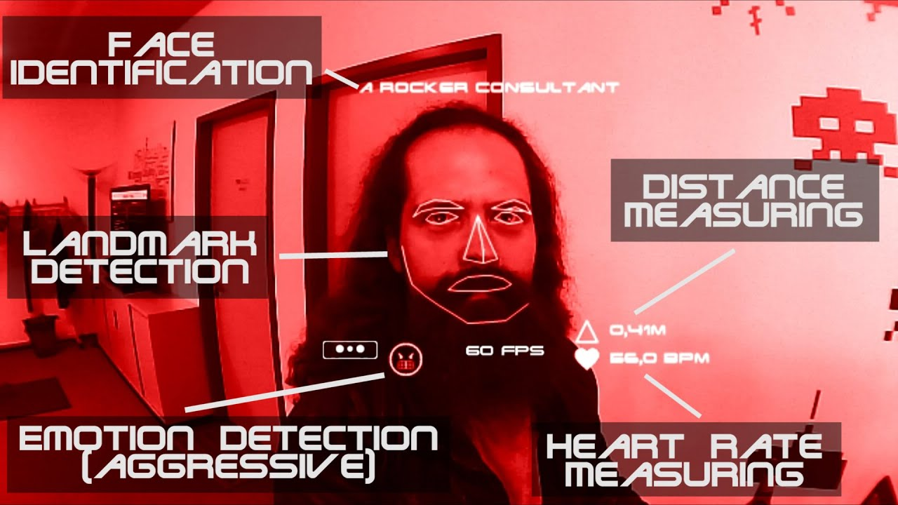

Slide 4

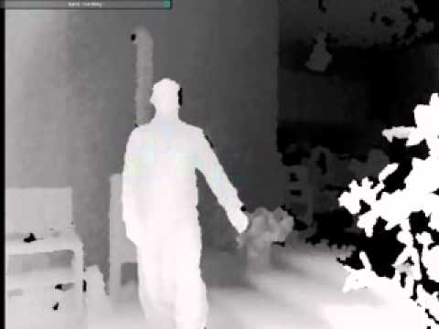
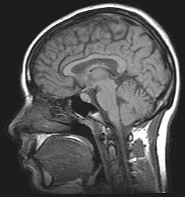
What is Computer Vision?
Computer vision is the science and technology of machines that see.
Concerned with the theory for building artificial systems that obtain information from images.
The image data can take many forms, such as a video sequence, depth images, views from multiple cameras, or multi-dimensional data from a medical scanner
Notes:
4

Slide 5

Computer Vision
Make computers understand images and videos.
What kind of scene?
Where are the cars?
How far is the building?
…

Slide 6

Components of a computer vision system
Camera
Lighting
Computer
Scene
Scene Interpretation
Srinivasa Narasimhan’s slide

Slide 7
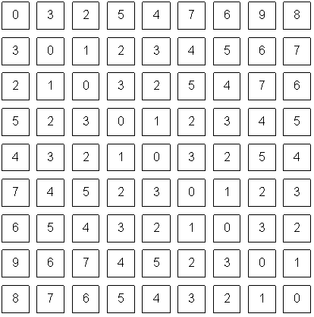
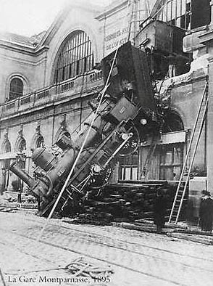
Computer vision vs human vision
What we see
What a computer sees

Slide 8
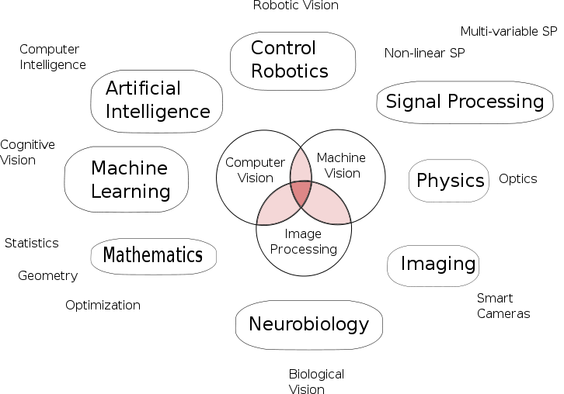
Vision is multidisciplinary
Computer Graphics
HCI
Wikipedia

Slide 9
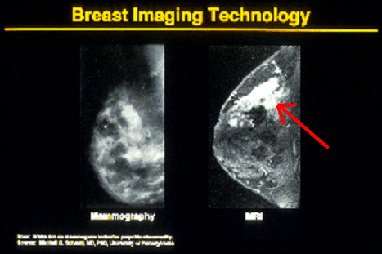




Why computer vision matters
Safety
Health
Security
Comfort
Fun
Access

